Slide 1
Graphs
Presentation for use with the textbook Data Structures and Algorithms in Java, 6th edition, by M. T. Goodrich, R. Tamassia, and M. H. Goldwasser, Wiley, 2014
1843
ORD
SFO
802
337
1743
LAX
1233
DFW

Slide 2
Graphs
A graph is a pair (V, E), where
V is a set of nodes, called vertices
E is a collection of pairs of vertices, called edges
Vertices and edges are positions and store elements
Example:
A vertex represents an airport and stores the three-letter airport code
An edge represents a flight route between two airports and stores the mileage of the route
849
PVD
1843
ORD
142
SFO
802
LGA
337
1743
1387
HNL
2555
1099
LAX
1233
DFW
1120
MIA

Slide 3
Edge Types
Directed edge
ordered pair of vertices (u,v)
first vertex u is the origin
second vertex v is the destination
e.g., a flight
Undirected edge
unordered pair of vertices (u,v)
e.g., a flight route
Directed graph
all the edges are directed
e.g., route network
Undirected graph
all the edges are undirected
e.g., flight network
flight
AA 1206
ORD
PVD
849
miles
ORD
PVD

Slide 4
Applications
Electronic circuits
Printed circuit board
Integrated circuit
Transportation networks
Highway network
Flight network
Computer networks
Local area network
Internet
Web
Databases
Entity-relationship diagram

Slide 5
Terminology
End vertices (or endpoints) of an edge
U and V are the endpoints of a
Edges incident on a vertex
a, d, and b are incident on V
Adjacent vertices
U and V are adjacent
Degree of a vertex
X has degree 5
Parallel edges
h and i are parallel edges
Self-loop
j is a self-loop
V
a
b
h
j
U
d
X
Z
c
e
i
W
g
f
Y

Slide 6
Terminology (cont.)
Path
sequence of alternating vertices and edges
begins with a vertex
ends with a vertex
each edge is preceded and followed by its endpoints
Simple path
path such that all its vertices and edges are distinct
Examples
P₁=(V,b,X,h,Z) is a simple path
P₂=(U,c,W,e,X,g,Y,f,W,d,V) is a path that is not simple
V
a
b
P₁
d
U
X
Z
P₂
h
c
e
W
g
f
Y

Slide 7
Terminology (cont.)
Cycle
circular sequence of alternating vertices and edges
each edge is preceded and followed by its endpoints
Simple cycle
cycle such that all its vertices and edges are distinct
Examples
C₁=(V,b,X,g,Y,f,W,c,U,a,↵) is a simple cycle
C₂=(U,c,W,e,X,g,Y,f,W,d,V,a,↵) is a cycle that is not simple
V
a
b
d
U
X
Z
C₂
h
e
C₁
c
W
g
f
Y

Slide 8
Properties
Property 1
Σ_{v} deg(v) = 2m
Proof: each edge is counted twice
Property 2
In an undirected graph with no self-loops and no multiple edges
m ≤ n (n − 1)/2
Proof: each vertex has degree at most (n − 1)
What is the bound for a directed graph?
Notation
n number of vertices
m number of edges
deg(v) degree of vertex v
Example
n = 4
m = 6
deg(v) = 3

Slide 9
Vertices and Edges
A graph is a collection of vertices and edges.
We model the abstraction as a combination of three data types: Vertex, Edge, and Graph.
A Vertex is a lightweight object that stores an arbitrary element provided by the user (e.g., an airport code)
We assume it supports a method, element(), to retrieve the stored element.
An Edge stores an associated object (e.g., a flight number, travel distance, cost), retrieved with the element( ) method.

Slide 10
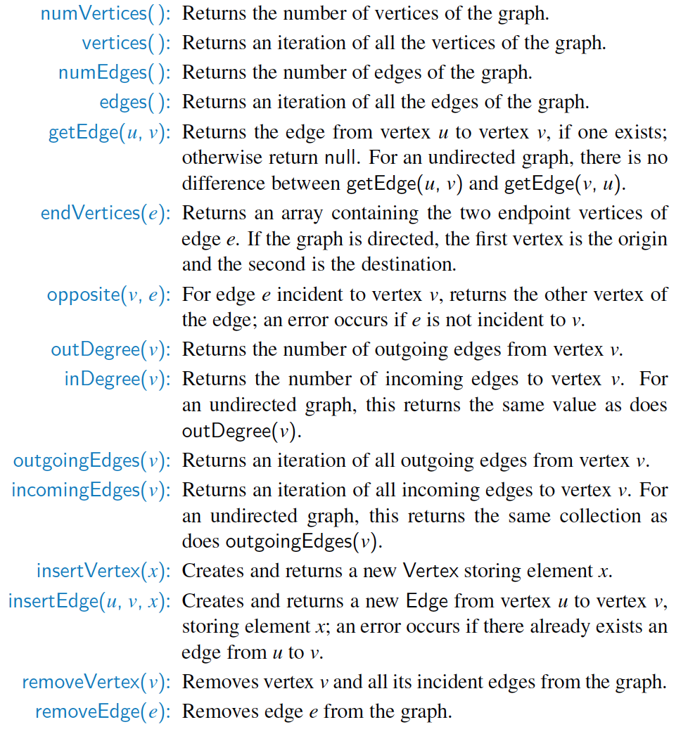
Graph ADT

Slide 11
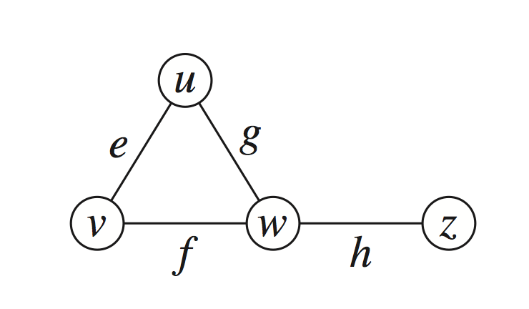
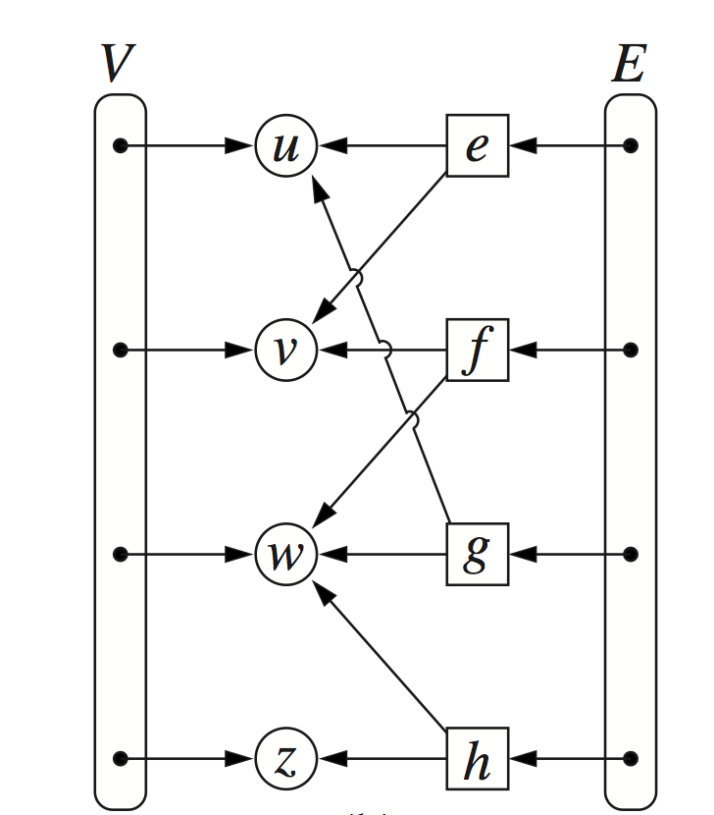
Edge List Structure
Vertex object
element
reference to position in vertex sequence
Edge object
element
origin vertex object
destination vertex object
reference to position in edge sequence
Vertex sequence
sequence of vertex objects
Edge sequence
sequence of edge objects

Slide 12
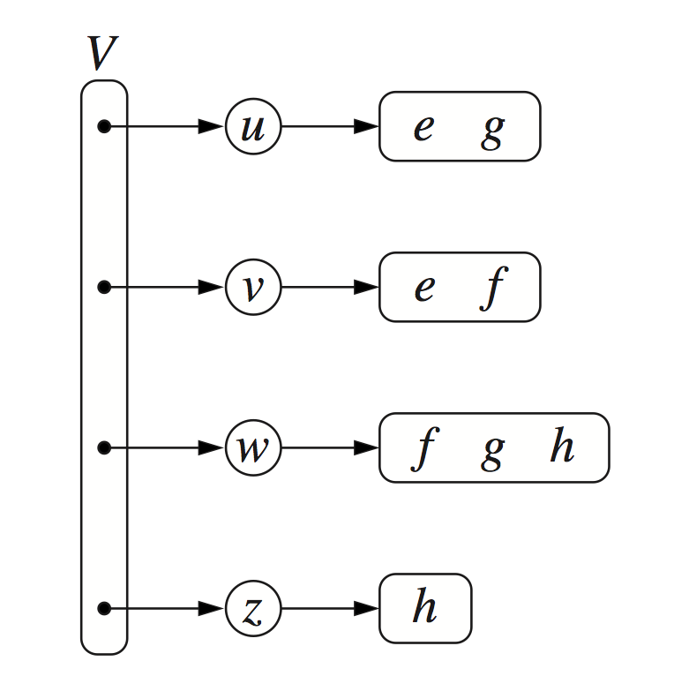
Adjacency List Structure
Incidence sequence for each vertex
sequence of references to edge objects of incident edges
Augmented edge objects
references to associated positions in incidence sequences of end vertices

Slide 13
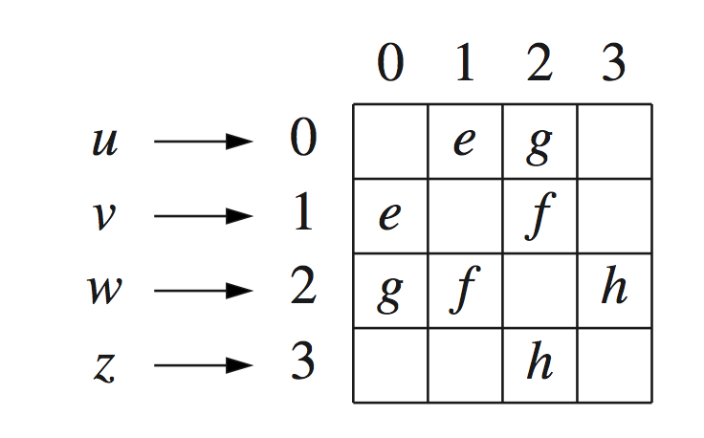
Adjacency Matrix Structure
Edge list structure
Augmented vertex objects
Integer key (index) associated with vertex
2D-array adjacency array
Reference to edge object for adjacent vertices
Null for non nonadjacent vertices
The “old fashioned” version just has 0 for no edge and 1 for edge

Slide 14
Performance
n vertices, m edges no parallel edges no self-loops | Edge List | Adjacency List | Adjacency Matrix
Space | n + m | n + m | n²
incidentEdges(v) | m | deg(v) | n
areAdjacent (v, w) | m | min(deg(v), deg(w)) | 1
insertVertex(o) | 1 | 1 | n²
insertEdge(v, w, o) | 1 | 1 | 1
removeVertex(v) | m | deg(v) | n²
removeEdge(e) | 1 | 1 | 1

